Slide 1


Ron Williams
Website Revamp And Digital Umbrella Creation
Created By:

Slide 2

Contents
Goals & Strategy
New Content
App Integrations
Wireframes
Mobile-Optimized Wireframes
Future Plans

Slide 3
Goals
Keeping visitors from quickly bouncing off your pages
Make library of downloadable information more accessible
More informative pages
To be more visually aligned with your brand
To improve navigation to average more pages per visit
To improve on-site SEO

Slide 4


Slide 5
Evolutionary Site Rollout
Less risky approach involves a process of testing with incremental improvements.
Creates a system of continuous improvement
Produces a better visitor experience

Slide 6
Strategy
Rephrased messaging
Clearly outlined goals and tasks
Setting a timeline
Contiguous feedback loop
Focus on customer journey
Bring everything under the RW umbrella

Slide 7
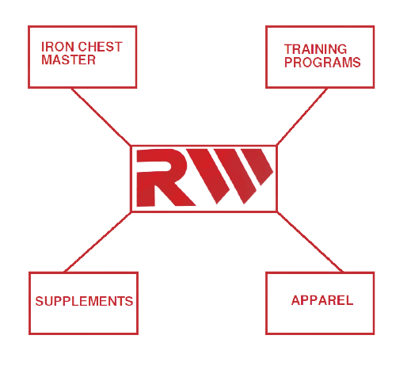

Slide 8
New Content
Photographs of Ron Williams - Working up a sweat with cardio - Pumping iron, flexin’ - Meal prep and mixing workout supplement drinks
Fast-paced quick-cut videos of RW work outs
Archival video footage of RW flexing at competitions
High-energy graphics for backgrounds that inspires and motivates people
Training content

Slide 9
App Integrations
App Integrations

Slide 10
Wireframes

Slide 11
Mobile-Optimized Wireframes

Slide 12
Future Plans
Apparel:
- T-shirts, jerseys, tank-tops, vests, shorts, hats, shoes - Face-masks, wristbands
Inventory - Belts & bags - Shaker bottle
RW Training Mobile App

